Slide 1
Using Desmos.com to Engage Students in Discovery Learning
John Herman john.herman@lakemills.k12.wi.us
Lake Mills High School

Slide 2
Background/Goals
Who has used Desmos before? Does anyone use it on a regular basis in their classes?
This is my first year incorporating it into my classes. I keep finding more and more great ways to use it in the learning process, particularly for discovery learning techniques
I’m not an expert, but want to share what I’ve been doing and learn from you too!

Slide 3
Agenda
Why use Desmos?
A quick overview of some features and how to use them
Time for questions, play, and working through some of the investigations
(Hopefully 20-30 minutes!)

Slide 4
Why I love Desmos
It’s free!
Very visually appealing (WAY better than TI-83/84)
Save and share graphs/data (free teacher account)
App on smartphones!
Intuitive to use- Students enjoy it and take to it very quickly! (Perfect for cell phone generation)
Lots of great resources (not just a calculator anymore!)
https://www.desmos.com/about

Slide 5
More specific reasons for desmos being awesome
Mathematical Concepts
Desmos Attributes
Lines
Statistics
Quadratics
Transformations of functions
Inequalities
Piece-wise functions
Non-functions/inverses
Trigonometry
Polar Graphs*
Parametric Functions*
Pre-made links for students
Sliders
Adjusting windows
Tables
Regression
Extrema of polynomials

Slide 6
The Basics
What’s a slider and how does it work?
How can I change the interval and animate a slider?
How can I graph a piece-wise function?

Slide 7
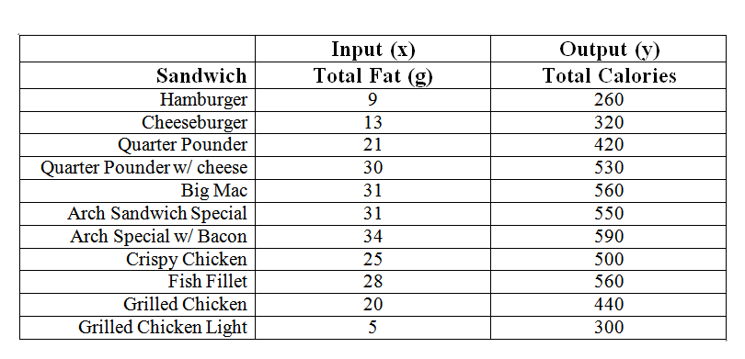
Don’t waste your students’ time entering points!
-You can copy entire tables from EXCEL
-You can share graphs or data!
https://www.desmos.com/calculator/ye7p0unqem
Desmos also does linear and non-linear regression!
y₁~mx₁+b Or y₁~ax₁^2+bx₁+c

Slide 8
Sliders are great way for students to get an intuitive feel for transformations.
https://www.desmos.com/calculator/3dzwl8ogyh
You will notice that equations do NOT need to be solved for y.

Slide 9
Inequalities are very simple to do.
https://www.desmos.com/calculator/kpw9aqkohq
Notice that Desmos can graph vertical lines, such as x=3.

Slide 10
Inverses are not a problem.
https://www.desmos.com/calculator/7oqbz8isyy
How do the graphs of inverses relate?

Slide 11
Desmos makes approximating extrema and intercepts simple.
https://www.desmos.com/calculator/t6qugveecy
Students will better understand how to do this algebraically after they graphically get a feel for the vocabulary.

Slide 12
Students can model the weather using sinusoidal waves.
Modeling Using Sinusoidal Waves Activity- (Included in your packet)

Slide 13
Desmos can also do parametric and polar equations.
https://www.desmos.com/calculator/nxy2er4wbz
You can change the coordinate plane to a polar coordinate system.

Slide 14
Beyond the calculator…
Discovery-based lessons
Make them on paper, or even using the program. I’ve included some to give you ideas.
Use others’ online lessons
Games/Math Activities
Marbleslides
Water-lines
Polygraph
Go to: teacher.desmos.com

Slide 15
How does Desmos compare?
What about Geogebra or Geometer’s Sketchpad?
In my humble opinion…
Geogebra?
-Also free!
-Better for Geometry
-More powerful but more complicated, and less intuitive
Geometer’s Sketchpad?
-Not free : (
-My favorite Geometry program
-Fairly simply to pick up for students and adults

Slide 16
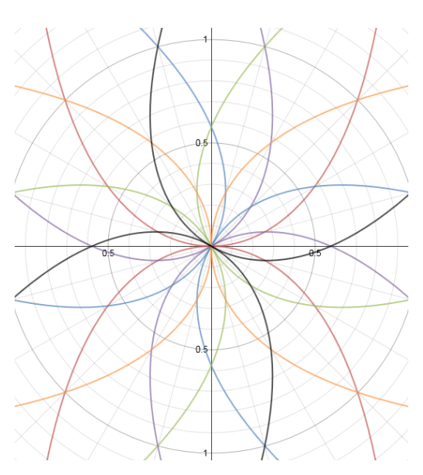
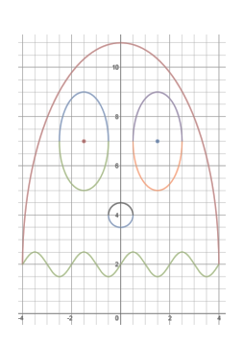
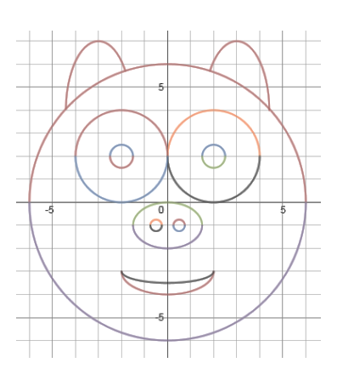
Lastly: It’s beautiful
Math can be a really beautiful thing
Can appeal to more visual learners, and to students that may not think that they are “math” people

Slide 17
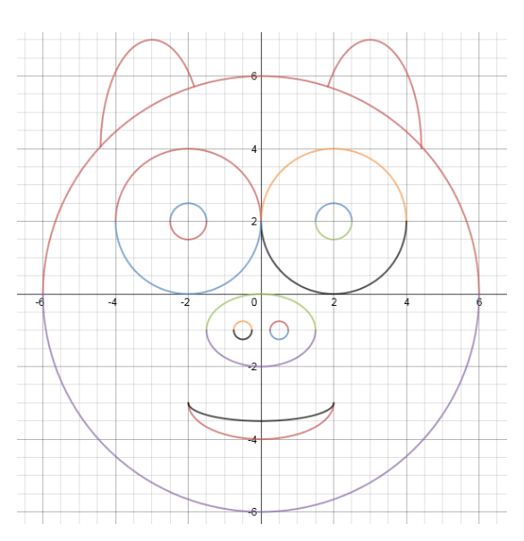
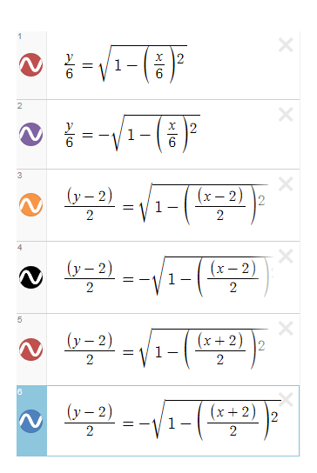
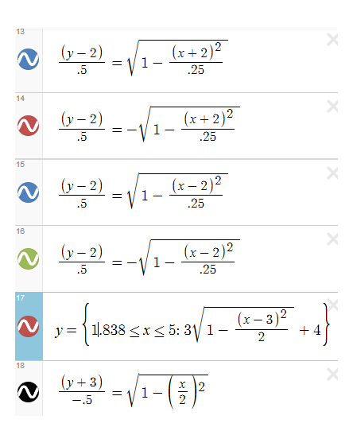
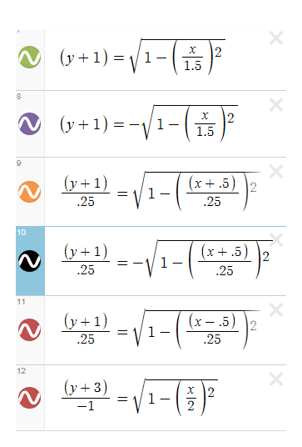
Student Work

Slide 18
Time to play
Please feel free to use our links and adjust them to fit your needs, or to create your own!
Try to have one Desmos application saved that will fit one of your upcoming math lessons!
Please feel free to share any uses you have found that we haven’t covered!

Slide 19
For the experts in the room…
For a challenge for you or your honors students, and some really trippy designs, check out:
http://dailydesmos.com/

Slide 20
Thanks for getting up early for this!
Questions? Comments? Want more of our stuff? Want to share stuff with us?
John Herman
John.herman@lakemills.k12.wi.us
Andrew Carroll
Andrew.carroll@lakemills.k12.wi.us

